Slide 1
ECEN 350 Electronic Devices and Circuits
Introduction and Circuit Analysis Review

Slide 2
Spiritual Thoughts
Please volunteer throughout the semester to share a short spiritual thought at the start of each class period.
See Spiritual Thought Sign-Up Sheet to sign up for a specific date to share a thought.
You can also find the above link by going to the Canvas module in Course Specifics.

Slide 3
Grading Overview
20% Prepare Reading and Post Discussion Quizzes
20% Homework
20% Labs
Encouraged to collaborate, but turn in your unique work submission and not someone else's.
Labs to be done individually, although you are encouraged to help others out.
Exams are open book, open note, similar to homework problems.
25% Exams
12.5% Final.
No makeups for these quizzes. Lowest 6 quiz scores for the semester dropped.
12.5% Midterm
15% Design Project
Student project involving design and constructi of a power supply, to be done individually.
Projects graded on submitted project report which includes performance measurements.

Slide 4
ECEN 350 - ebook and Software
Text: The text “Electronic Principles” 9th Edition, Malvino, Bates and Hoppe, is required for this course.
Through a company named Vitalsource, BYU-Idaho provides Automatic Access to an ebook version of this text through I-Learn for all enrolled in the class, for a 5 year time period. You will automatically be billed a cost of approximately $46 for ebook access, with payment due after the semester drop deadline. If you have made other arrangements for a text, such as purchasing a hardcopy version, then you can opt out of the $46 charge on your account. In addition to the ebook, you can pick up a loose leaf hardcopy version of the text at the Bookstore for an additional $35. You will need to either have your loose leaf copy spiral bound (< $10.00 at the copy center) or purchase a binder, with three-ring binders available at the Bookstore.
To access the ebook text go to the Course Materials link found amongst the many links located on left-hand side of the Canvas course Home page. Note: You must create a Vitalsource account (Username and password) to access the ebook.
After the initial ebook access through Canvas, you should then access the ebook through Vitalsource.
LTspice & MATLAB
Also download and install LTspice from the Analog Devices web site using the following link: LTspice. While not required for ECEN 350, MATLAB is another helpful resource. See the following link for instructions: MATLAB Installation Instructions.

Slide 5
iClicker for In-Class Quizzes
We will be using the iClicker Student Mobile app for phones or laptops for in-class quizzes.
If you already have an iClicker account using your BYU-I email then you will automatically be enrolled.
If you are new to iClicker at BYU-I, then you need to create an account by visiting student.iclicker.com.
Click on Sign Up,.
Create account with Brigham Young University-Idaho as your Institution.
Use your BYU-I email, else your account won’t work for Grade Syncing at BYU-I.
If you have the wrong email on existing iClicker account, you can update your account at student.iclicker.com → Profile.
For Phones and/or Laptops
Install the iClicker Student Mobile App on your mobile Device as follows:
Download the iClicker Student Mobile app from your native app store or go to iclicker.com.

Slide 6
Piazza – Italian Word for Plaza
Piazza is a collaborative Q&A tool, accessed through Canvas, that is intended to aid in in asking and answering each others questions.
You can post questions by name or annonymously, and also answer questions posted by others.
Answers to questions can be upvoted so that the best answers appear first.
Since questions can be asked anonymously, please don’t let your important questions go unanswered.
Piazza is organized by folders that include “general technical questions”, ‘quizzes”, “hws”, “labs”, “logistics” and “other”. The “hws” and “labs” folders have subfolders for individual assignments. So please navigate to the appropriate folder prior to posting.
Piazza is to be the main way of asking course related questions outside of class and/or help sessions.
Piazza is an online way to “Teach One Another”, which is an important process in the BYU-I Learning model.
A short homework assignment due in two days asks you to Post → Note on Piazza.

Slide 7
ECEN 350 Format and Success Tips
Prepare reading quizzes covering prepare reading material due before class with no make-ups.
Post discussion quizzes near the end of class with no make-ups. Notes taken during class can be used on these quizzes. (6 lowest quiz scores for the semester automatically dropped by Canvas.)
Download and use the class slides presented in class, all of which are available on Canvas. These slides include worked examples similar to many homework problems.
Two open-book tests throughout the semester; a midterm and a final exam.
Strive to understand the concepts, as that produces a better harvest than simply memorizing material to pass a test.
Those who to take “Personal Responsibility for Their Education” demonstrating “Self-Regulation” have a stronger foundation and more to offer future employers and end up with more rewarding jobs, along with better compensation.
Getting help when needed is a trademark of perseverance or grit: a desire to push forward and use whatever help necessary to accomplish our goals.
Wednesday (5:00 to 7:30 pm) and Saturday (11:00 – 1:30 pm) in-person and Zoom help sessions for HW and Labs.
See the following document for helpful personal resources: Helpful Resources.

Slide 8
Homework and Lab Assignments
Most homework and lab assignments involve downloading a Word docx file, adding your work including answers with units, then uploading your completed document as a docx or pdf before the due date. Submit your assignments in either docx or pdf format so that they can be read by the grader.
5% per day with a maximum of 50% late penalty for homework and lab assignments, unless extenuating circumstances as determined by the instructor.
Work in groups on homework so as to teach one another, although turn in your own work. Identical homework submissions are considered plagiarism and assigned a grade of 0.
Well documented homework and lab submissions will likely come in handy in your engineering future, so do yourself a favor and document well enough so that they are useful to you in your future.
Becoming proficient with the Word equation editor is a useful skill for engineering students. Please view the following video on using the Word equation editor: Word Equation Editor Tutorial.
Writing is one of the most important forms of communication in industry. Hence, good writing skill will greatly benefit your future careers. Lab reports provide opportunities for you to practice writing.
Canvas Lab Notices indicate which lab is to be worked on at that time, with lab help time available on Friday.

Slide 9
The Myth of Multitasking
We all tend to think we are good at doing more that one thing at a time, which is mostly true for some tasks such as reading while eating a snack or listening to the radio while driving.
Yet we are not good at reading or working on homework assignments while watching a movie, sometimes referred to as multitasking.
According to Dave Crenshaw, multitasking is a myth, as when trying to read while watching a movie we are actually switching tasks back and forth, and the switching adds a cognitive load, leaving less mental resources available for the tasks at hand.
Russell Poldrack, a psychology professor at the University of California, Los Angeles, found that “multitasking adversely affects how you learn. Even if you learn while multitasking, that learning is less flexible and more specialized, so you cannot retrieve the information as easily”. His research demonstrates that people use different areas of the brain for learning and storing new information when they are distracted.
According to an Article by John Naish, studies have shown that it takes longer to do multiple cognitive challenging tasks when multitasking, as compared to doing each task serially. Also multitasking has a negative physical effect, prompting the release of stress hormones and adrenaline.
What about doing homework while watching a movie?
You would be less stressed, remembering the material better and enjoy the movie more by doing these tasks serially.

Slide 10
Remote Attendance Issues
In previous semesters Remote (Zoom) attendees statistically do worse grade wise that than in-class attendees.
Yet Remote (Zoom) attendees that exhibit self-regulation have been quite successful.
Choose wisely regarding whether to attend in-class or remote.
Learning to be effective in remote meetings is becoming an important life skill.
Please attend remote if you are ill and/or contagious.
Remote Class Attendance Success Tips
Remote attendees participate as if they were physically present, meaning turning cameras on, while muting microphones when not speaking in order to minimize audio interference.
Remote attendees abide by the CES Honor Code, which includes the BYUI-Idaho Dress and Grooming Standards. The CES Honor code applies to all enrolled students both on and off campus.
Remote attendees take personal responsibility to minimize unnecessary distractions, along with multitasking (task swapping) during class meetings.

Slide 11
Cheating/Plagiarism
100% of BYU-I Students that knowingly cheat in their classes regret or will regret their cheating.
Demonstrating integrity and trustworthiness is of more importance than any letter grade you get in any college class.
“Today I am going to give you two examinations: one on circuit analysis (trigonometry) and one on honesty. I hope you will pass them both. But if you must fail one, let it be circuit analysis (trigonometry). For there are many good people in the world today who cannot pass an examination on circuit analysis (trigonometry), but there are no good people in the world today who cannot pass an examination on honesty”. Paraphrased from “As a Man Soweth” by L. Tom Perry, April 1976 General Conference.
People cheat to get ahead, but ironically end up further behind in the long term. Be wise!
First item on the CES Honor Code is “Be Honest”.
Plagiarism – Putting your name on someone else’s work. This is Academic Dishonesty.
In the past, some have used paid on-line services to solve most of their homework problems. While you are encouraged to ask for help when needed, you can’t become proficient by having someone else do your work.
HW and Lab keys available one day after due date and a submission. Canvas records when you download documents.
Once you have downloaded a HW or Lab key, you are no longer eligible to submit that assignment.

Slide 12
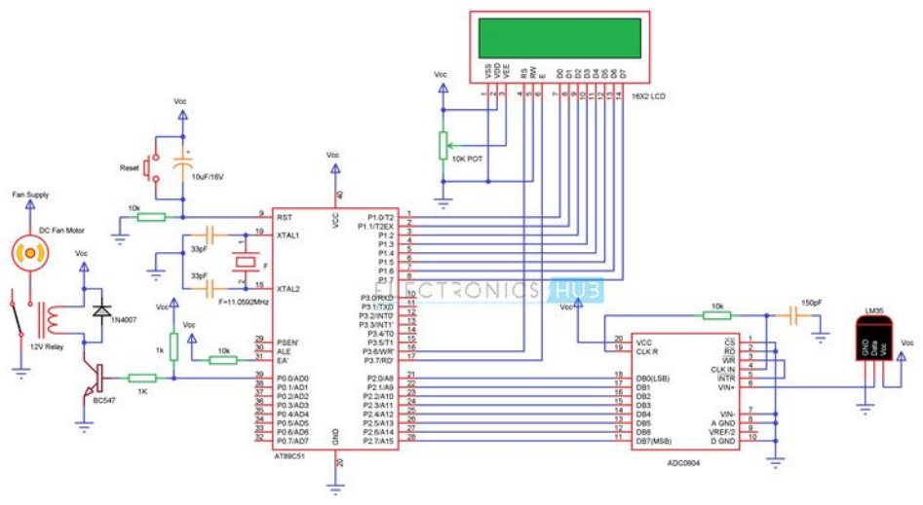
Microcontroller Circuit Example
Schematics are somewhat like a foreign language, that electrical and computer engineers need to learn to speak.
Temperature Controlled DC Fan
Trim
Pot
DC Fan
Microcontroller
Temperature
Sensor
Mechanical
Relay
ADC

Slide 13
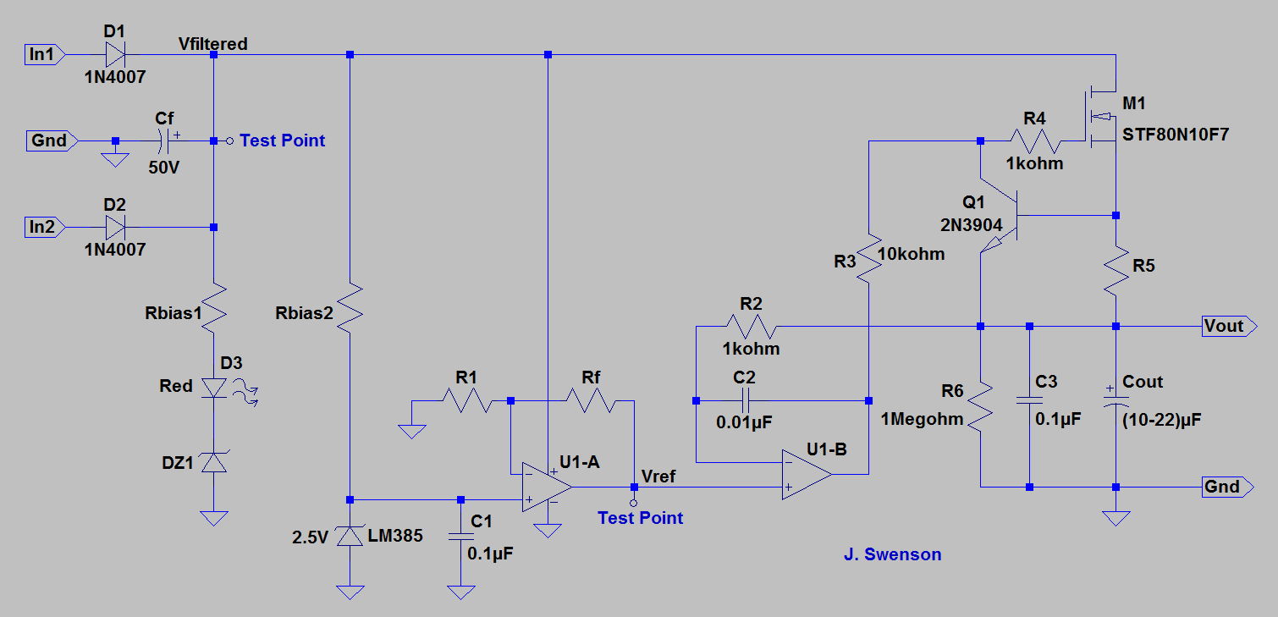
ECEN 350 - DC Power Supply Project

Slide 14
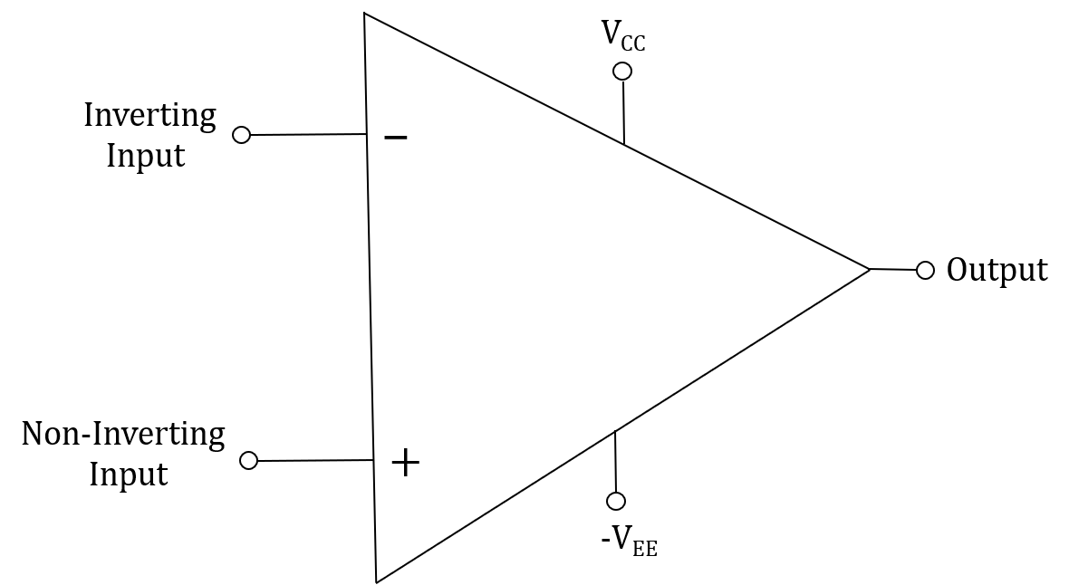
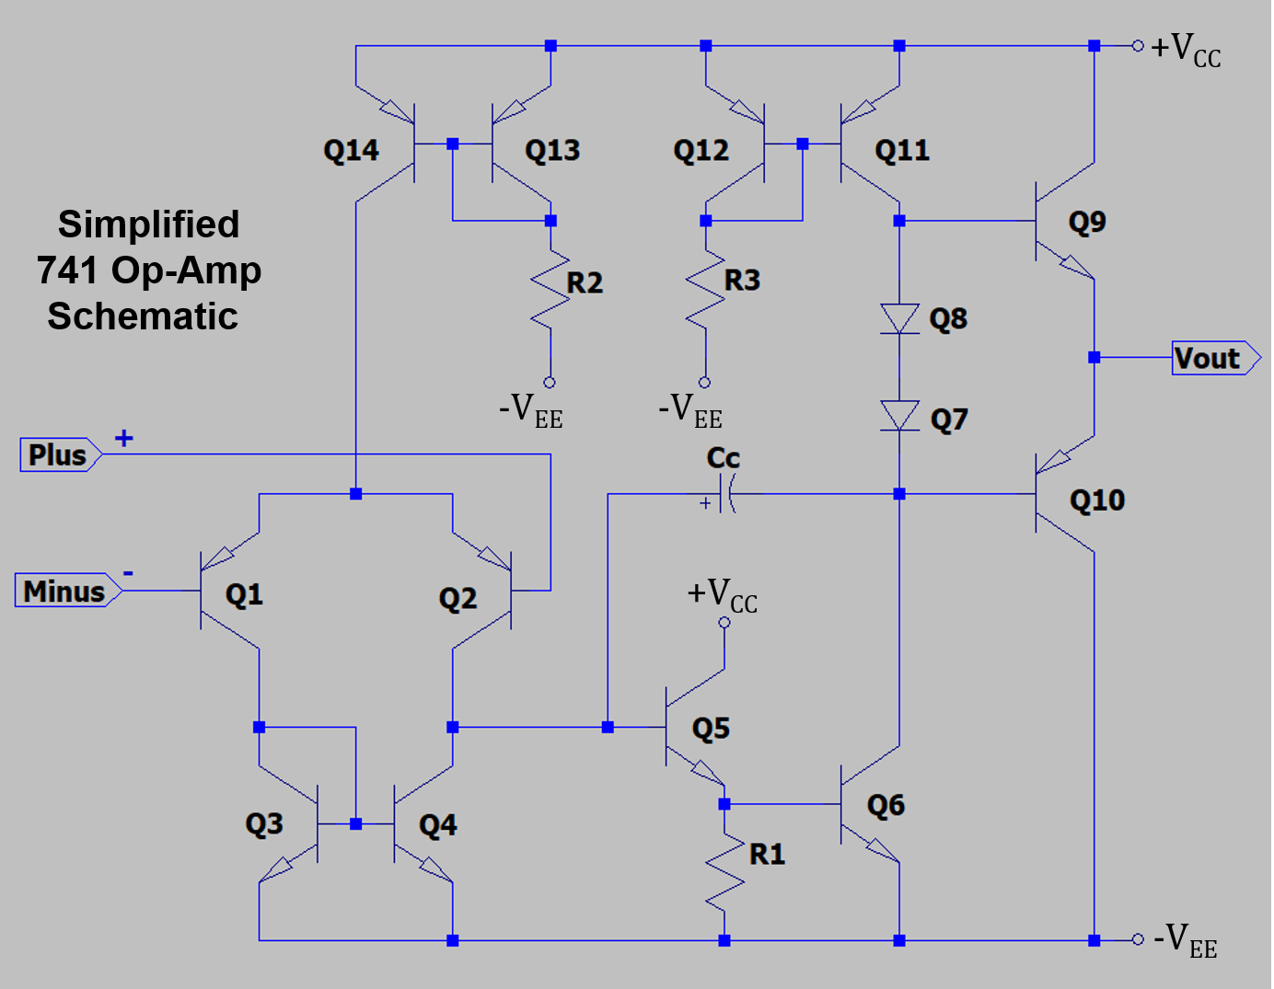
Simplified 741 IC Op-Amp Schematic
741 op-amp utilizes bipolar junction transistors, resistors,
diodes and a capacitor, all integrated into one silicon chip or IC, and
costing less that $1.00 in quantity.
IC op-amps are umbiquitous in modern circuit designs.
Op-amps are used for signal conditioning and buffering in microcontroller measurement applications
Op-amp questions are commonly asked during technical hiring interviews.

Slide 15
Ideal Op-Amps
Ideal op-amp assumptions:
1. Infinite open-loop voltage gain.
2. Infinite input resistance, meaning current into the two input
terminals equals 0 A.
3. Zero output resistance, which is the assumption made for an ideal
voltage source.
An additional ideal op-amp assumption is that when negative feedback is incorporated we assume that the voltage difference between the inverting and non-inverting inputs equals 0 V.
Negative feedback means a wire or component like a resistor or transistor is connected between the output and the inverting (minus) input.
Why can we assume the voltage difference between the minus and plus inputs is zero when negative feedback
is present?
Because of large open-loop voltage gain and the utility of negative feedback. Many op-amps have a dc gain ≥ 1,000,000. With this large open-loop gain, a tiny voltage difference between the + and – inputs causes a large output voltage excursion. If V_{p} < V_{m} then the Output goes towards -V_{EE}. If V_{p} > V_{m} then Output goes towards V_{CC}.

Slide 16
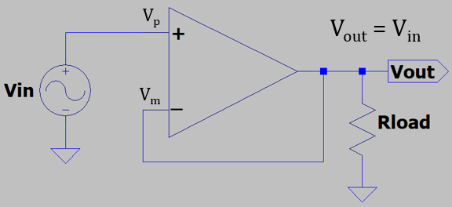
Feedback Control
Feedback control: Inverted Pendelum
Feedback control is used to keep the bottom (-) end of the pendulum in vertical alignment with the top (+) end, with the controller constantly minimizing any difference. As a result, the bottom (-) end follows the vertical position of the top (+) end of the inverted pendulum. The horizontal corrective response of the controller has to be larger than any misalignment to keep the pendelum inverted, making large horizontal gain and quick response time desirable. The larger the vertical mis-alignment, the larger the corrective response to minimize the misallignment.
Feedback control: Voltage Follower
Feedback control is used to keep the minus (-) input of the op-amp equal to the plus (+) input, with the op-amp output constantly minimizing any difference. As a result, the minus (-) input follows the voltage of the plus (+) input of the op-amp when the output is connected to the minus (-) input, referred to as negative feedback. The corrective response of the op-amp has to be larger than any |v_{p} - v_{m}|, for the output to follow the input, making large open-loop voltage gain and quick response time desirable. The larger the magnitude of v_{p} - v_{m},, i.e., |v_{p} - v_{m}|, the larger the corrective response to minimize |v_{p} - v_{m}|.

Slide 17
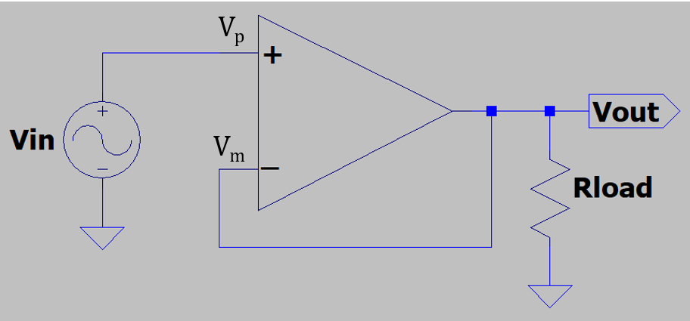
Ideal Voltage Follower
What is V_{out} and why in the adjacent circuit?
V_{p} = V_{m}. Also, V_{p} = V_{in}. Therefore V_{out} = V_{in}. V_{out} is said to follow V_{in}.
Why does V_{p} = V_{m}?
Because of large open-loop voltage gain and negative feedback, V_{out} is always adjusts V_{m} towards V_{p}.
If V_{out} became < V_{in}, then V_{p} > V_{m}, resulting in V_{out} increasing until V_{m} again equals V_{p}.
If V_{out} became > V_{in}, then V_{p} < V_{m}, resulting in V_{out} decreasing until V_{m} again equals V_{p}.
The only time that V_{out} is not adjusting V_{m} towards V_{p}, is when V_{m} = V_{p}, which implies V_{out} = V_{in}. Hence, V_{out} follows V_{in}.
The further away V_{m} is from V_{p}, the more forcefully V_{out} adjusts V_{m} towards V_{p}.
The closer V_{m} is to V_{p}, the less forcefully V_{out} adjusts V_{m} towards V_{p}.
Since V_{out} = V_{in}, the resulting voltage gain with feedback, i.e. closed-loop gain = 1 because of negative feedback, whereas open-loop gain >> 1.

Slide 18
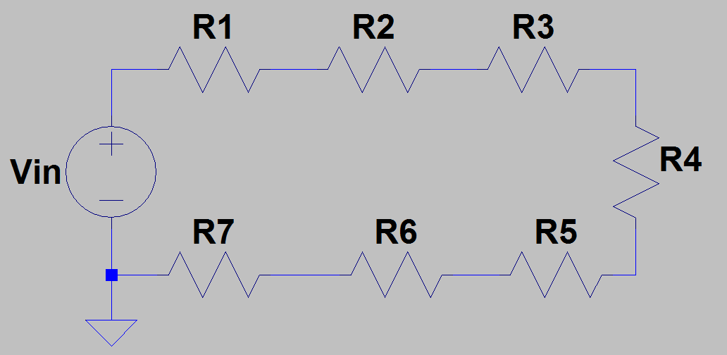
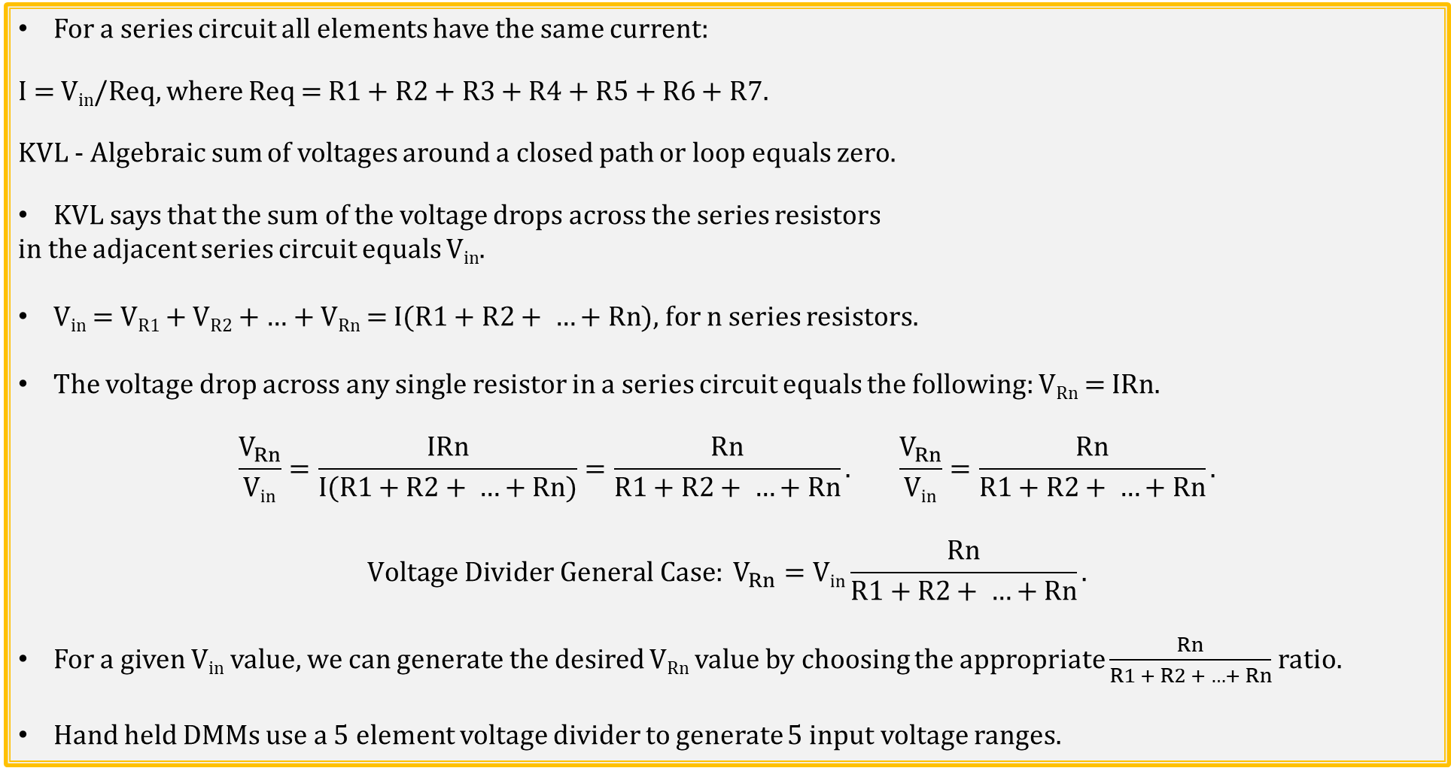
Voltage Divider → General Case
For a series circuit all elements have the same current:
I = V_{in}/Req, where Req = R1 + R2 + R3 + R4 + R5 + R6 + R7.
KVL - Algebraic sum of voltages around a closed path or loop equals zero.
KVL says that the sum of the voltage drops across the series resistors
in the adjacent series circuit equals V_{in}.
V_{in} = V_{R1} + V_{R2} + … + V_{Rn} = I($R1+R2+ …+Rn$), for n series resistors.
The voltage drop across any single resistor in a series circuit equals the following: V_{Rn} = IRn.
$$\frac{V_{Rn}}{\text{V}\text{in}}=\frac{IRn}{I(R1+R2+ …+Rn)}=\frac{Rn}{R1+R2+ …+Rn}. \frac{V_{Rn}}{\text{V}\text{in}}=\frac{Rn}{R1+R2+ …+Rn}.$$
$$Voltage Divider General Case: V_{Rn}=\text{V}\text{in}\frac{Rn}{R1+R2+ …+Rn}.$$
For a given V_{in} value, we can generate the desired V_{Rn} value by choosing the appropriate $\frac{Rn}{R1 + R2 + …+ Rn}$ ratio.
Hand held DMMs use a 5 element voltage divider to generate 5 input voltage ranges.
Notes:
Image by instructor

Slide 19
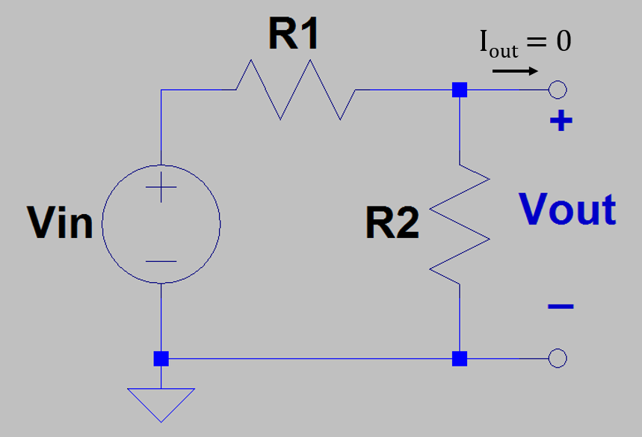
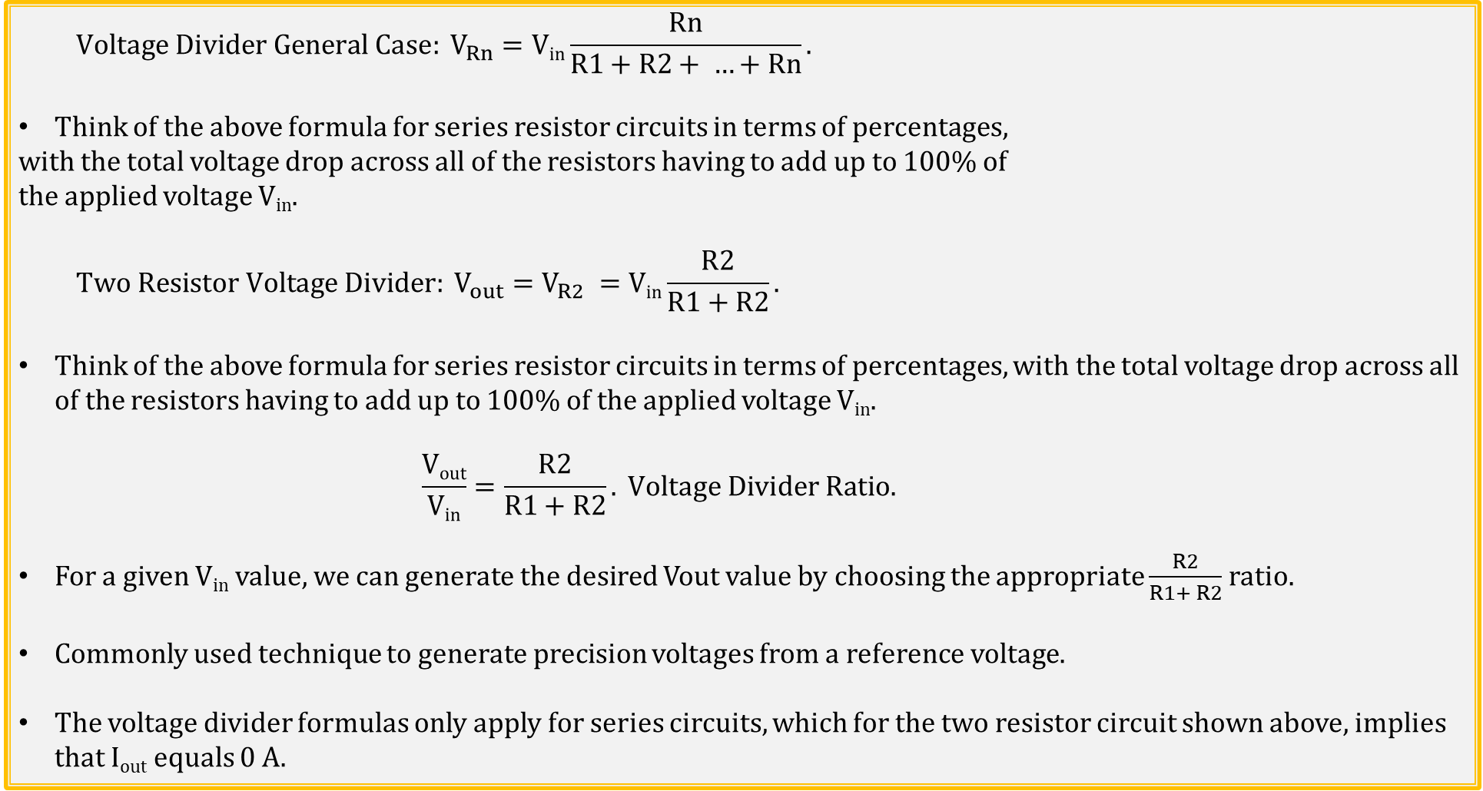
Voltage Divider → Two Resistors
$$Voltage Divider General Case: V_{Rn}=\text{V}\text{in}\frac{Rn}{R1+R2+ …+Rn}.$$
Think of the above formula for series resistor circuits in terms of percentages,
with the total voltage drop across all of the resistors having to add up to 100% of
the applied voltage V_{in}.
$$Two Resistor Voltage Divider: V_{out}=V_{R2} =\text{V}\text{in}\frac{R2}{R1+R2}.$$
Think of the above formula for series resistor circuits in terms of percentages, with the total voltage drop across all of the resistors having to add up to 100% of the applied voltage V_{in}.
$$\frac{\text{V}\text{out}}{\text{V}\text{in}}=\frac{R2}{R1+R2}. Voltage Divider Ratio.$$
For a given V_{in} value, we can generate the desired Vout value by choosing the appropriate $\frac{R2}{R1+ R2}$ ratio.
Commonly used technique to generate precision voltages from a reference voltage.
The voltage divider formulas only apply for series circuits, which for the two resistor circuit shown above, implies that I_{out} equals 0 A.
Notes:
Image by instructor

Slide 20
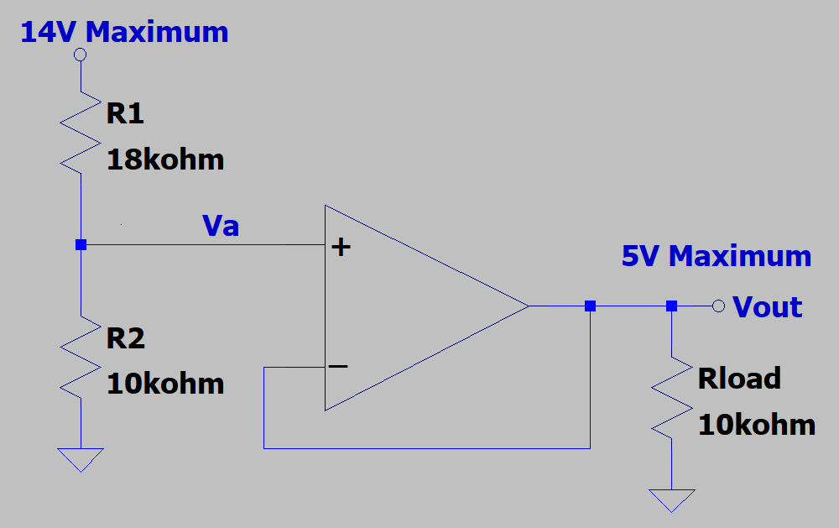
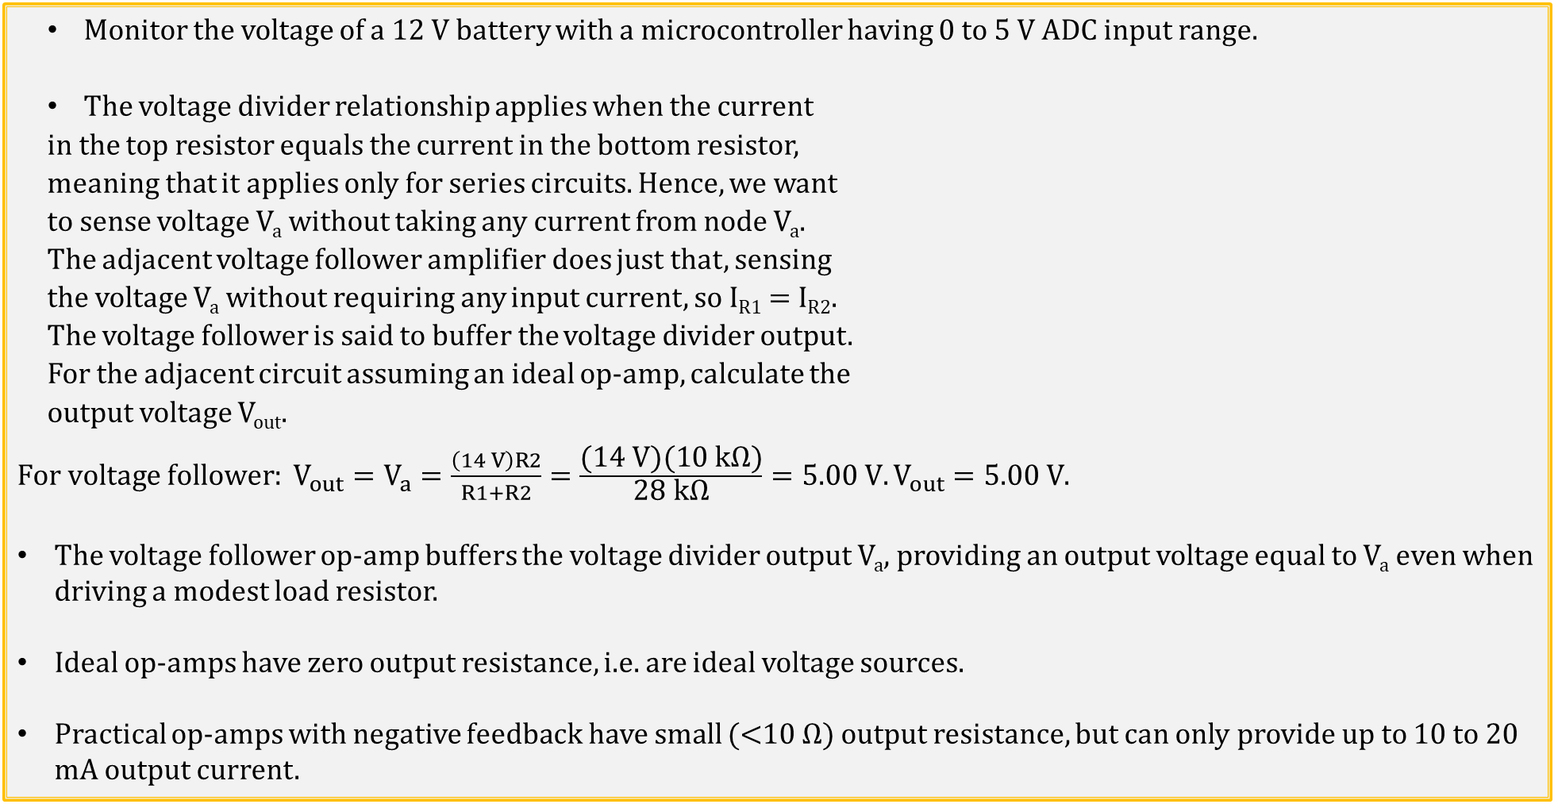
Voltage Divider and Follower Application
Monitor the voltage of a 12 V battery with a microcontroller having 0 to 5 V ADC input range.
The voltage divider relationship applies when the current
in the top resistor equals the current in the bottom resistor,
meaning that it applies only for series circuits. Hence, we want
to sense voltage V_{a} without taking any current from node V_{a}.
The adjacent voltage follower amplifier does just that, sensing
the voltage V_{a} without requiring any input current, so I_{R1} = I_{R2}.
The voltage follower is said to buffer the voltage divider output.
For the adjacent circuit assuming an ideal op-amp, calculate the
output voltage V_{out}.
$For voltage follower: V_{out}=V_{a}=\frac{\left(14 V\right)R2}{R1+R2}=\frac{\text{(}\text{14} \text{V}\text{)(10 }\text{k}\text{Ω)}}{\text{28} \text{k}\text{Ω}}=5.00 V.V_{out}=5.00 V$.
The voltage follower op-amp buffers the voltage divider output V_{a}, providing an output voltage equal to V_{a} even when driving a modest load resistor.
Ideal op-amps have zero output resistance, i.e. are ideal voltage sources.
Practical op-amps with negative feedback have small (<10 Ω) output resistance, but can only provide up to 10 to 20 mA output current.

Slide 21
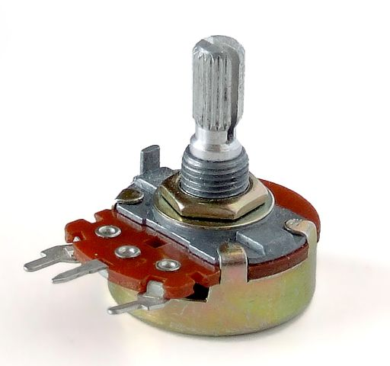
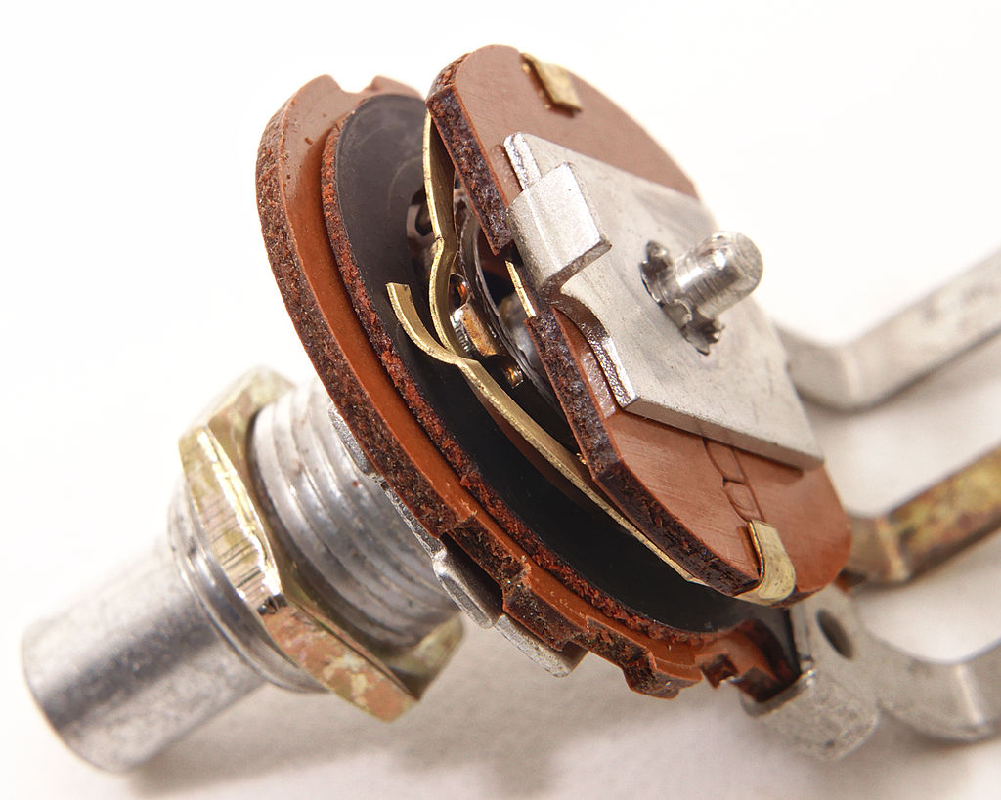
Potentiometer – Adjustable Voltage Divider
Circuit Symbol
Wiper Terminal
This device is referred to as a Trim Pot,
i.e., Trim Potentiometer.
Notes:
https://commons.wikimedia.org/wiki/File%3ASingle-turn_potentiometer_with_internals_exposed%2C_oblique_view.jpg
https://commons.wikimedia.org/wiki/File%3APotentiometer.jpg

Slide 22
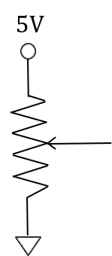
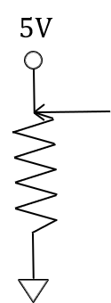
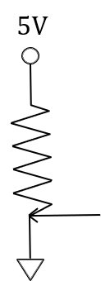
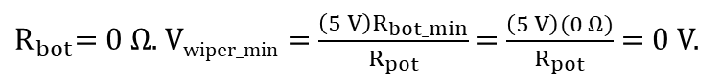
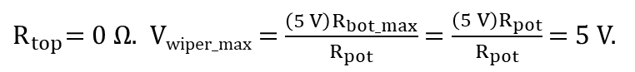
Potentiometer – Adjustable Voltage Divider
R_{top}
R_{pot}
V_{wiper} = $\frac{\left(5 V\right)R_{bot}}{R_{top}+{ R}_{bot}}$. $R_{top}+{ R}_{bot}$ = R_{pot} . V_{wiper} = $\frac{\left(5 V\right)R_{bot}}{R_{pot}}$. If R_{bot} = R_{top}, then V_{wiper} = 2.5 V.
R_{bot}
$R_{top}$= $0 Ω$. V_{wiper_max} = $\frac{\left(5 V\right)R_{bot_max}}{R_{pot}}$ = $\frac{\left(5 V\right)R_{pot}}{R_{pot}}$ = 5 V.
R_{pot}
R_{pot}
$R_{bot}$= $0 Ω$. V_{wiper_min} = $\frac{\left(5 V\right)R_{bot_min}}{R_{pot}}$ = $\frac{\left(5 V\right)(0 Ω)}{R_{pot}}$ = 0 V.

Slide 23
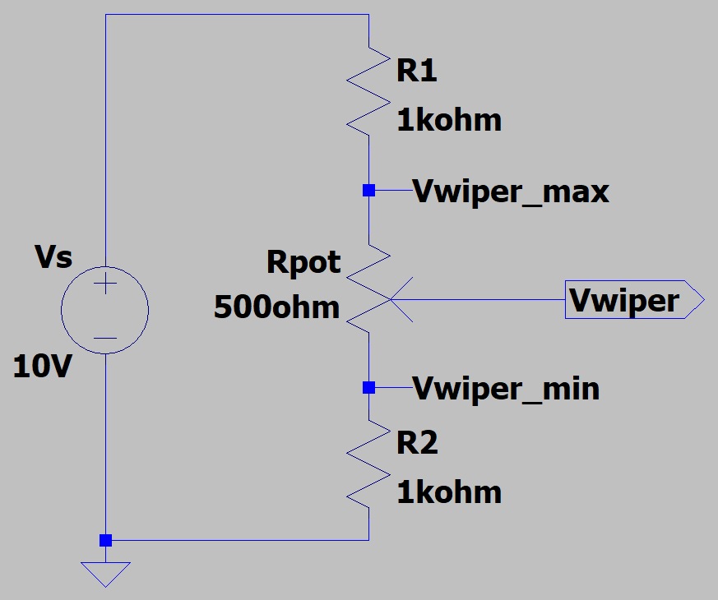
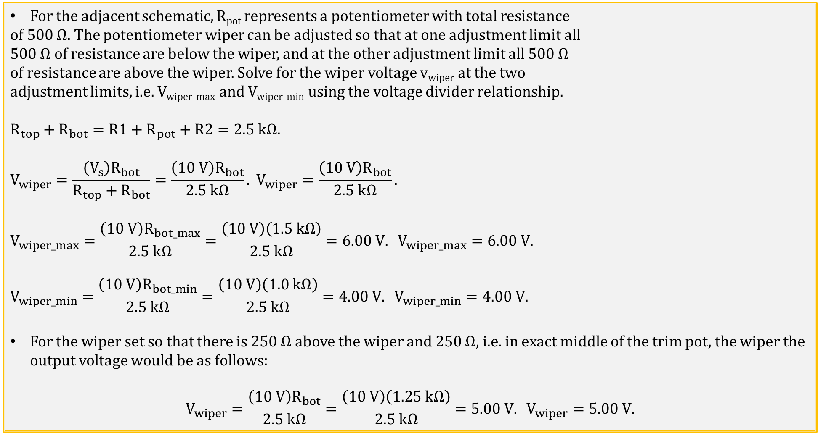
Potentiometer Example
For the adjacent schematic, R_{pot} represents a potentiometer with total resistance
of 500 Ω. The potentiometer wiper can be adjusted so that at one adjustment limit all
500 Ω of resistance are below the wiper, and at the other adjustment limit all 500 Ω
of resistance are above the wiper. Solve for the wiper voltage v_{wiper} at the two
adjustment limits, i.e. V_{wiper_max} and V_{wiper_min} using the voltage divider relationship.
$$R_{top}+R_{bot}=R1+R_{pot}+R2=2.5 kΩ.$$
$$V_{wiper}=\frac{\left(V_{s}\right)R_{bot}}{R_{top}+R_{bot}}=\frac{\left(10 V\right)R_{bot}}{2.5 kΩ}. V_{wiper}=\frac{\left(10 V\right)R_{bot}}{2.5 kΩ}.$$
$$V_{wiper_max}=\frac{\left(10 V\right)R_{bot_max}}{2.5 kΩ}=\frac{\left(10 V\right)\left(1.5 kΩ\right)}{2.5 kΩ}=6.00 V. V_{wiper_max}=6.00 V.$$
$$V_{wiper_min}=\frac{\left(10 V\right)R_{bot_min}}{2.5 kΩ}=\frac{\left(10 V\right)\left(1.0 kΩ\right)}{2.5 kΩ}=4.00 V. V_{wiper_min}=4.00 V.$$
For the wiper set so that there is 250 Ω above the wiper and 250 Ω, i.e. in exact middle of the trim pot, the wiper the output voltage would be as follows:
$$V_{wiper}=\frac{\left(10 V\right)R_{bot}}{2.5 kΩ}=\frac{\left(10 V\right)\left(1.25 kΩ\right)}{2.5 kΩ}=5.00 V. V_{wiper}=5.00 V.$$

Slide 24
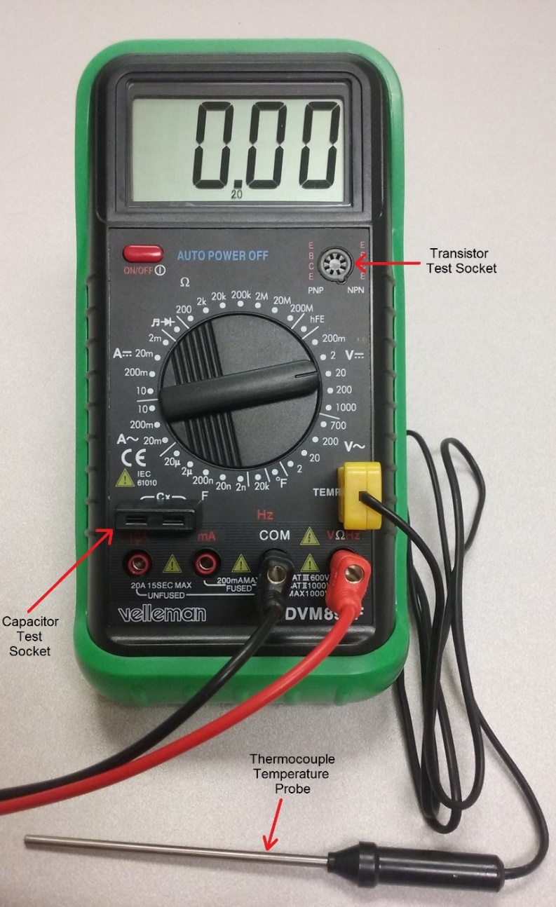
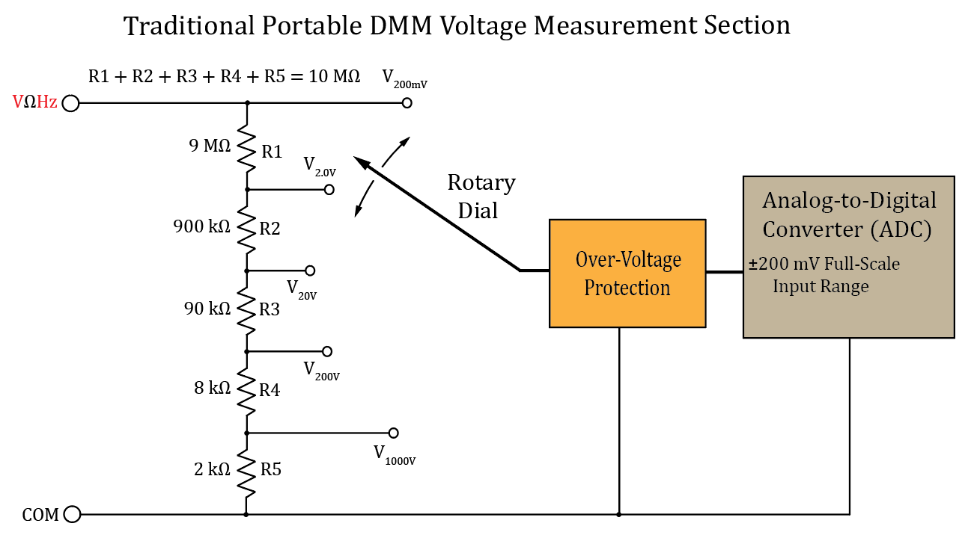
Digital Multi-Meter → DMM
Hand held DMMs use a 5 element voltage divider to generate 5 input voltage ranges.
While this is an inexpensive way to arrive at 5 different voltage ranges, it results in an input resistance/impedance of 10 MΩ.
Consequently, when measuring a 10 V DC input, the DMM takes (10 V)/(10 M Ω) = 1 µA from the circuit.
While this is not noticeable for most circuits, it becomes noticeable for high-resistance, i.e. low-current circuits.
Notes:
Image by instructor

Slide 25
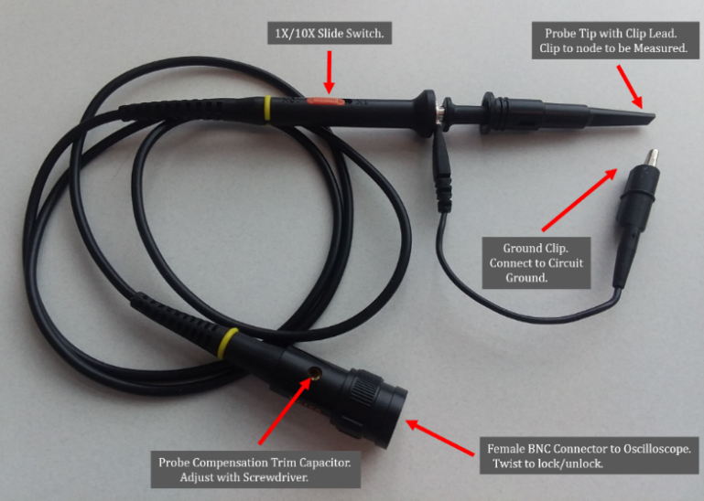
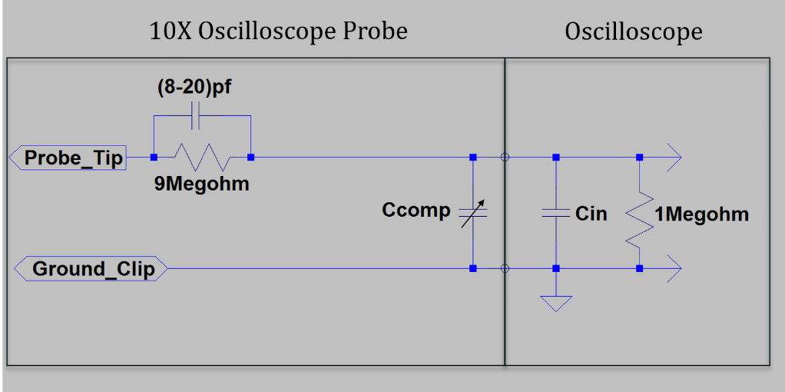
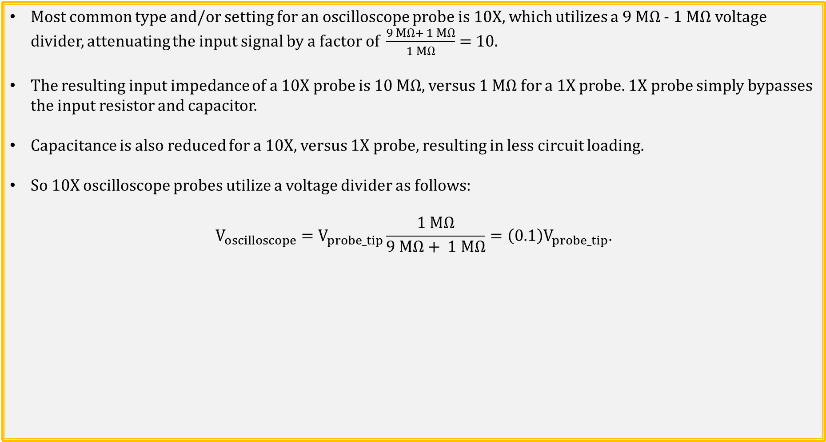
10X and 1X Oscilloscope Probes
Most common type and/or setting for an oscilloscope probe is 10X, which utilizes a 9 MΩ - 1 MΩ voltage divider, attenuating the input signal by a factor of $\frac{9 MΩ+ 1 MΩ}{1 MΩ}=$10.
The resulting input impedance of a 10X probe is 10 MΩ, versus 1 MΩ for a 1X probe. 1X probe simply bypasses the input resistor and capacitor.
Capacitance is also reduced for a 10X, versus 1X probe, resulting in less circuit loading.
So 10X oscilloscope probes utilize a voltage divider as follows:
$$V_{oscilloscope}=V_{probe_tip}\frac{1 MΩ}{9 MΩ+ 1 MΩ}=\left(0.1\right)V_{probe_tip}.$$
Notes:
Image by instructor

Slide 26
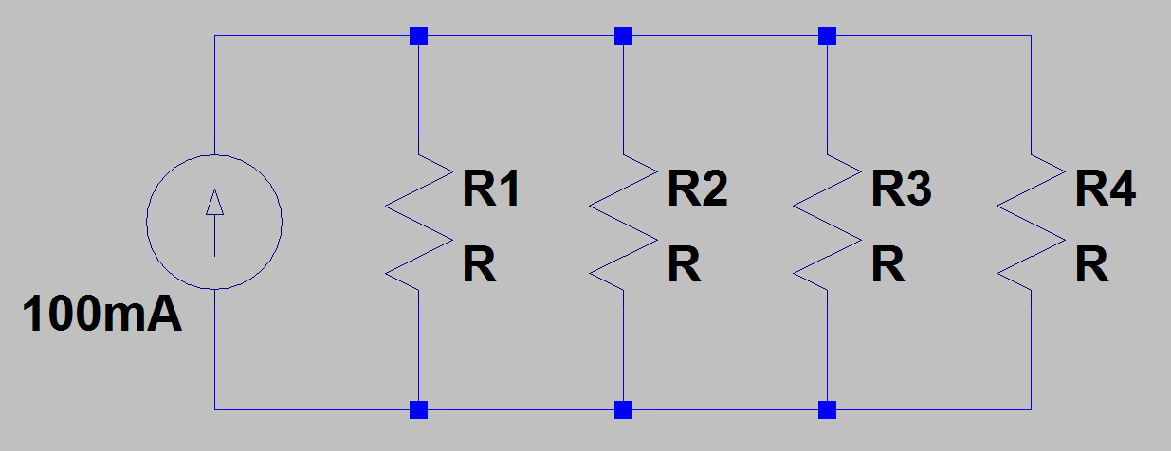
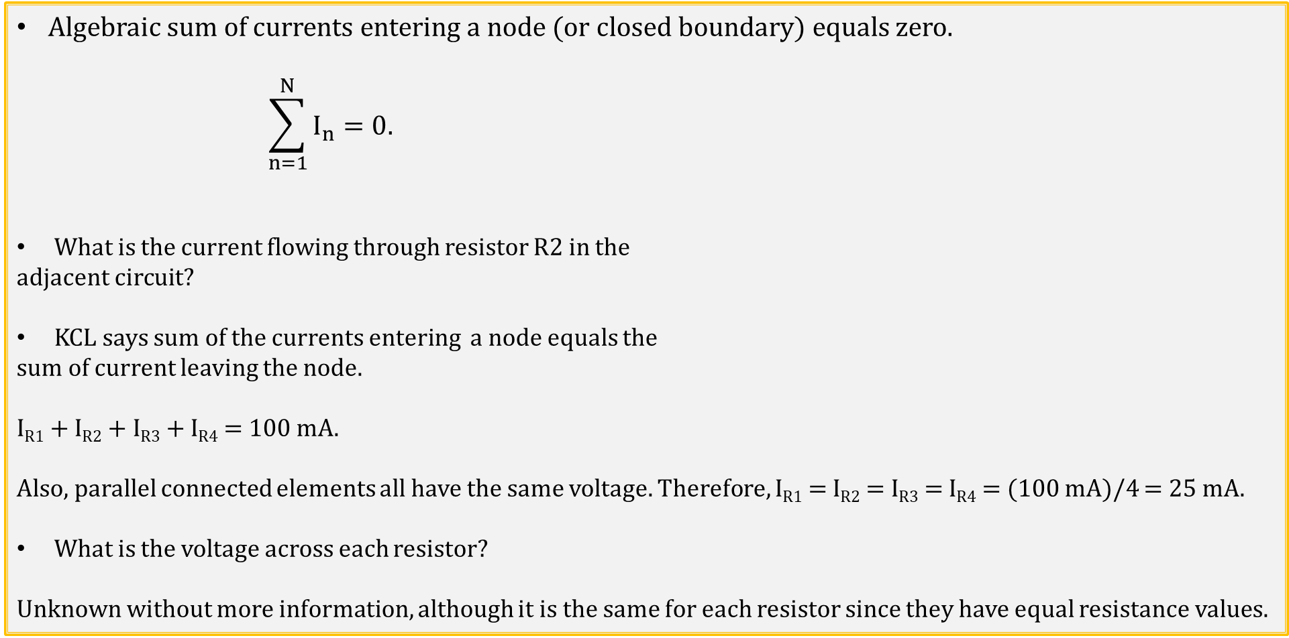
Kirchhoff’s Current Law (KCL)
Algebraic sum of currents entering a node (or closed boundary) equals zero.
$$\sum_{n=1}^{N}{I_{n}=0.}$$
What is the current flowing through resistor R2 in the
adjacent circuit?
KCL says sum of the currents entering a node equals the
sum of current leaving the node.
I_{R1} + I_{R2} + I_{R3} + I_{R4} = 100 mA.
Also, parallel connected elements all have the same voltage. Therefore, I_{R1} = I_{R2} = I_{R3} = I_{R4} = (100 mA)/4 = 25 mA.
What is the voltage across each resistor?
Unknown without more information, although it is the same for each resistor since they have equal resistance values.
Notes:
Image by instructor

Slide 27
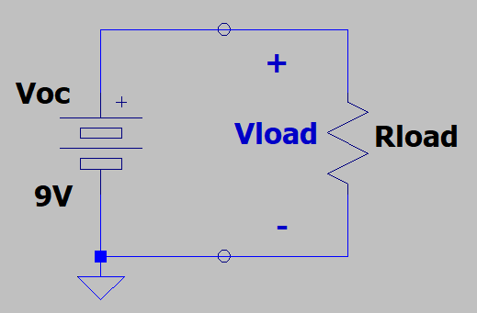
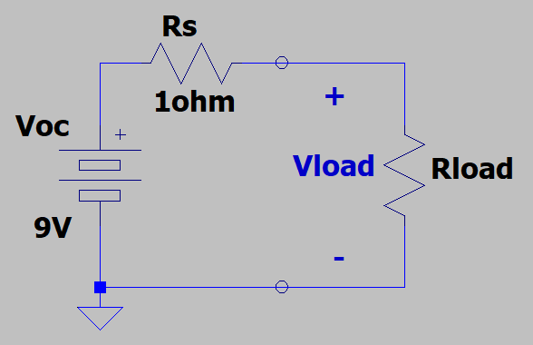
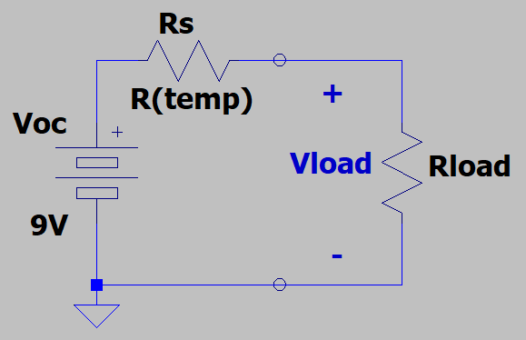
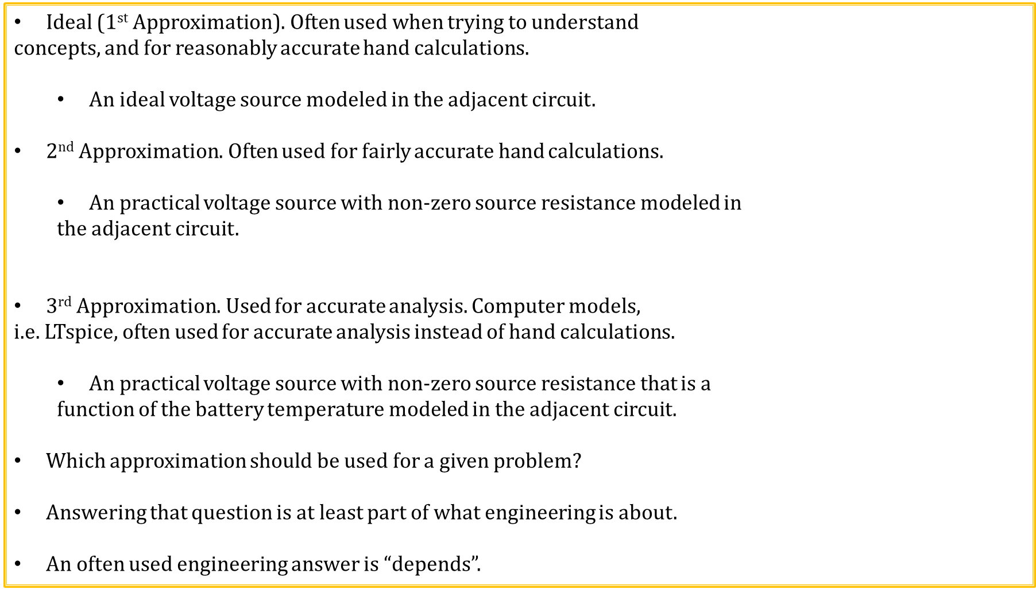
Approximations
Ideal (1st Approximation)$.$ Often used when trying to understand
concepts, and for reasonably accurate hand calculations.
An ideal voltage source modeled in the adjacent circuit.
2nd Approximation$.$ Often used for fairly accurate hand calculations.
An practical voltage source with non-zero source resistance modeled in
the adjacent circuit.
3rd Approximation$.$ Used for accurate analysis. Computer models,
i.e. LTspice, often used for accurate analysis instead of hand calculations.
An practical voltage source with non-zero source resistance that is a
function of the battery temperature modeled in the adjacent circuit.
Which approximation should be used for a given problem?
Answering that question is at least part of what engineering is about.
An often used engineering answer is “depends”.

Slide 28
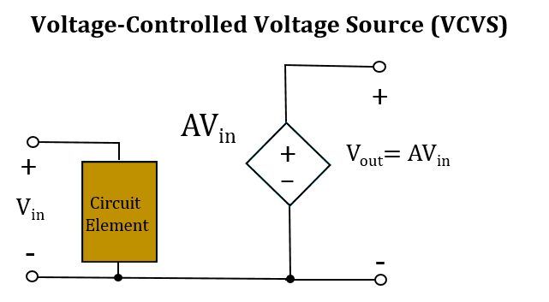
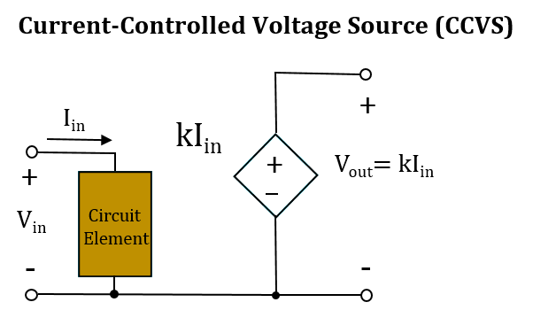
Dependent Voltage Sources
Op-Amp Model

Slide 29
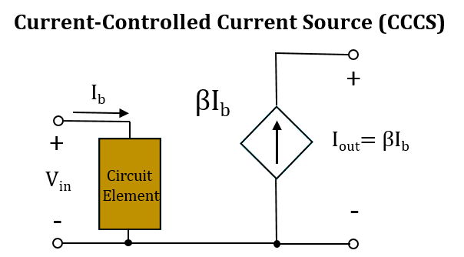
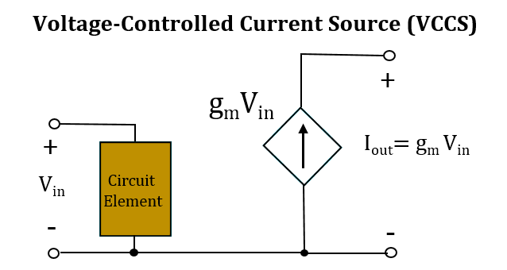
Dependent Current Sources
Bipolar Transistor Model
MOS Transistor Model

Slide 30
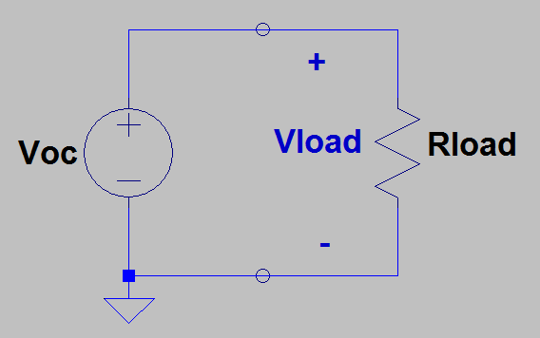
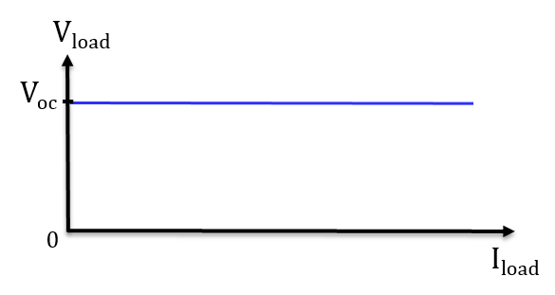
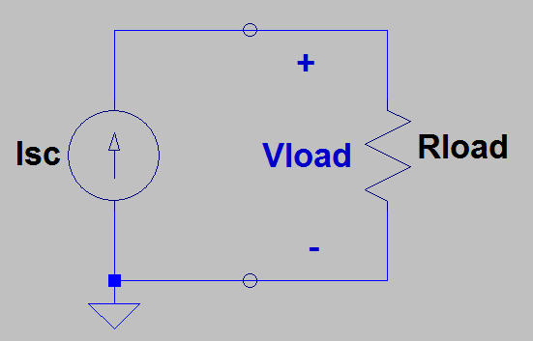
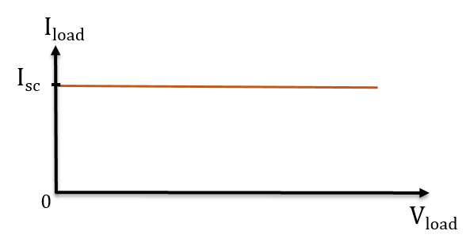
Voltage and Current Sources
An ideal voltage source provides the desired voltage no matter how much current is required.
Hence, an ideal voltage source is independent of current.
An ideal current source provides the desired current no matter how much voltage is required.
Hence, an ideal current source is independent of voltage.

Slide 31
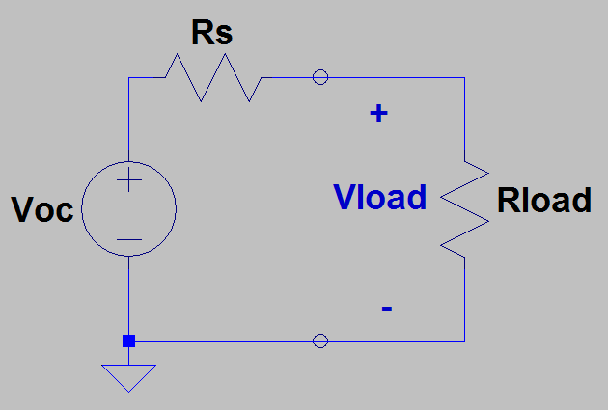
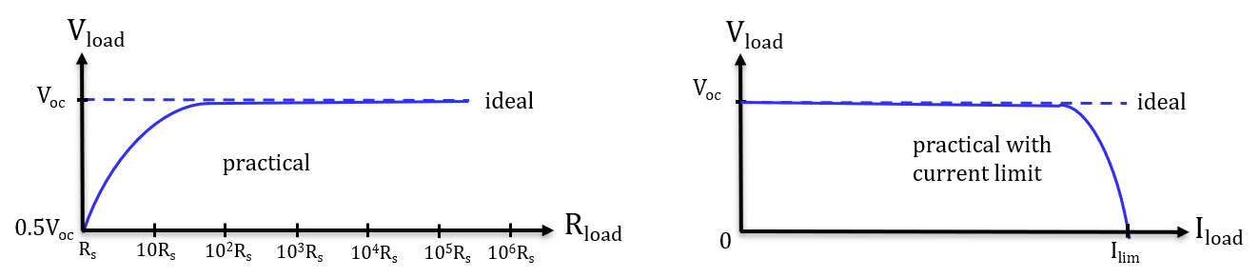
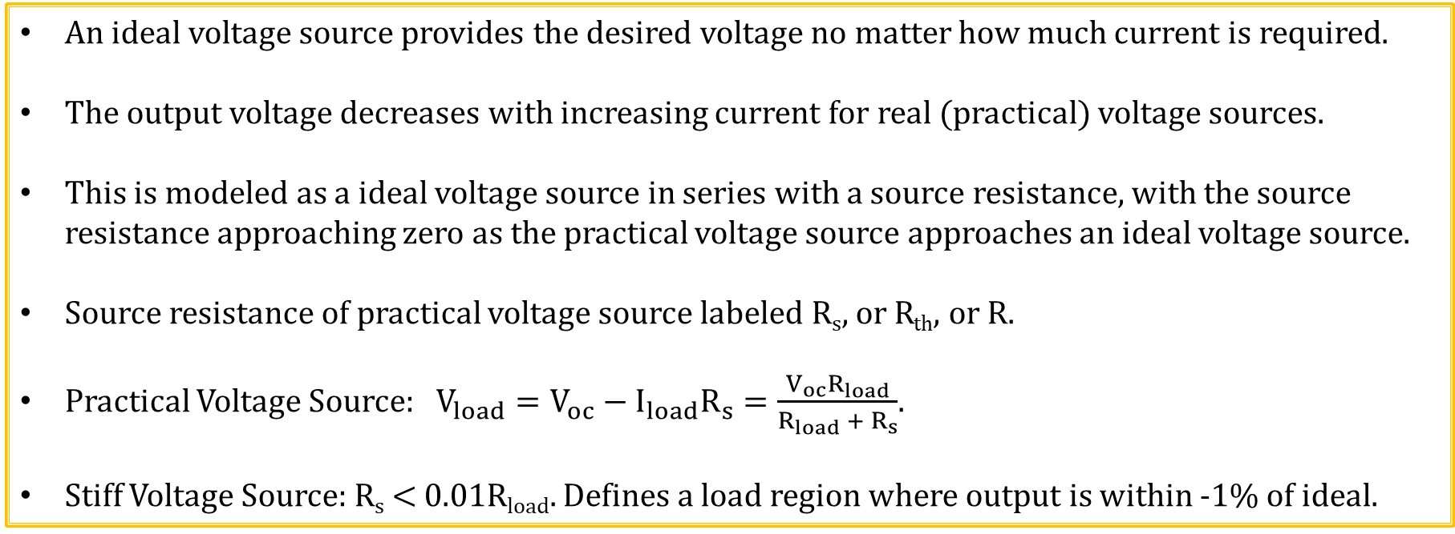
Practical Voltage Sources
An ideal voltage source provides the desired voltage no matter how much current is required.
The output voltage decreases with increasing current for real (practical) voltage sources.
This is modeled as a ideal voltage source in series with a source resistance, with the source resistance approaching zero as the practical voltage source approaches an ideal voltage source.
Source resistance of practical voltage source labeled R_{s}, or R_{th}, or R.
Practical Voltage Source: $V_{load}=V_{oc}−I_{load}R_{s}=\frac{V_{oc}R_{load}}{R_{load} +{ R}_{s}}$.
Stiff Voltage Source: R_{s} < 0.01R_{load}. Defines a load region where output is within -1% of ideal.

Slide 32
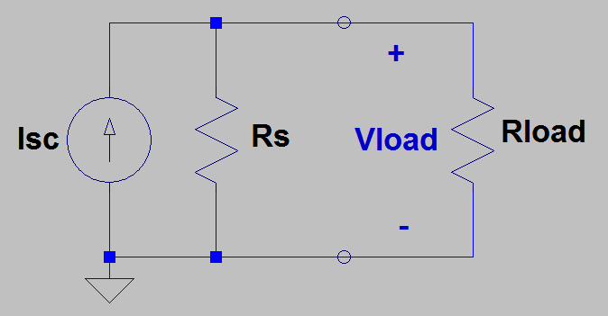
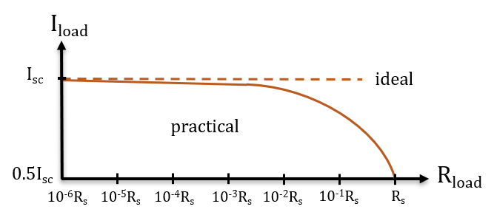
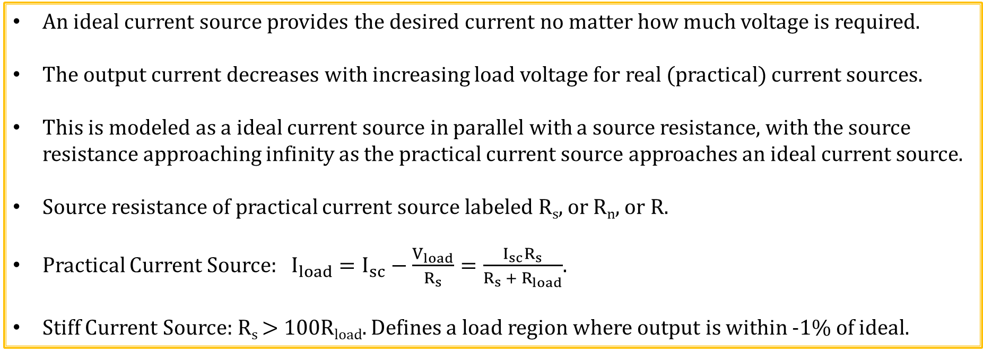
Practical Current Sources
An ideal current source provides the desired current no matter how much voltage is required.
The output current decreases with increasing load voltage for real (practical) current sources.
This is modeled as a ideal current source in parallel with a source resistance, with the source resistance approaching infinity as the practical current source approaches an ideal current source.
Source resistance of practical current source labeled R_{s}, or R_{n}, or R.
Practical Current Source: $I_{load}=I_{sc}−\frac{V_{load}}{R_{s}}=\frac{I_{sc}R_{s}}{R_{s} +{ R}_{load}}$.
Stiff Current Source: R_{s} > 100R_{load}. Defines a load region where output is within -1% of ideal.

Slide 33
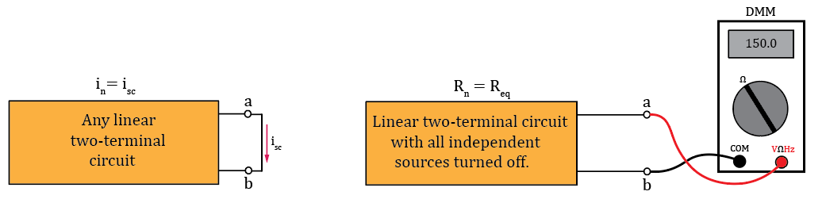
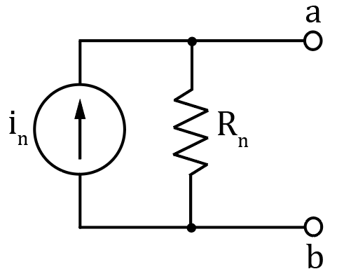
Norton’s Theorem
Any linear two-terminal circuit can be replaced by a current source (I_{n}) in parallel with a resistance (R_{n}). The current source (I_{n}) is the short-circuit current at the output terminals and the resistance (R_{n}) is the equivalent resistance between the output terminals with all independent sources turned off.
The Norton’s Equivalent circuit is a practical current source.
The resulting Norton’s equivalent circuit provides equivalent
performance as the original circuit with regards to an external load.
The Norton resistance R_{n} is equivalent to the Thevenin resistance R_{th}.
Norton’s Theorem Diagrams
Notes:
Image by instructor

Slide 34
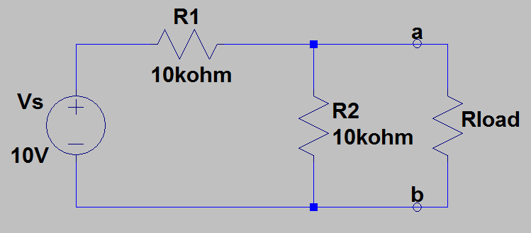
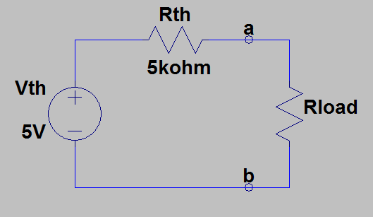
Thevenin’s Theorem Example 1
Find the Thevenin’s equivalent circuit
left of terminals a and b.
First remove Rload, to open-circuit
terminals a - b in order to find V_{th} and R_{th}.
V_{th} = V_{ab} = V_{s}R2/(R1 + R2)
V_{th} = (10 V)(10 kΩ)/(20 kΩ) = 5.0 V.
V_{th} = 5.0 V.
R_{th} = R1ǁR2 = (10 kΩ)(10 kΩ)/(20 kΩ) = 5 kΩ.
R_{th} = 5 kΩ.
Now can load output and solve for load
voltages and currents using simplified
Thevenin’s equivalent.
Notes:
Image by instructor

Slide 35
Norton’s Theorem
Any linear two-terminal circuit can be replaced by a current source (I_{n}) in parallel with a resistance (R_{n}). The current source (I_{n}) is the short-circuit current at the output terminals and the resistance (R_{n}) is the equivalent resistance between the output terminals with all independent sources turned off.
The Norton’s Equivalent circuit is a practical current source.
The resulting Norton’s equivalent circuit provides equivalent
performance as the original circuit with regards to an external load.
The Norton resistance R_{n} is equivalent to the Thevenin resistance R_{th}.
Norton’s Theorem Diagrams
Notes:
Image by instructor

Slide 36


Norton’s Theorem Example 1
Find the Norton’s equivalent circuit
left of terminals a and b.
First short-circuit the a - b terminals
in order to find I_{n}.
I_{n} = V_{s}/(R1 + R3) = (10 V)/(20 kΩ)
I_{n} = 0.5 mA. I_{n} = 0.5 mA.
Next remove the a –b terminal short, set V_{s}= 0, and look into the a – b terminals to determine R_{n}.
R_{n} = (R1 + R3)ǁR2.
R_{n} = (20 kΩ)(10 kΩ)/(20 kΩ + 10 kΩ) = 6.67 kΩ.
R_{n} = 6.67 kΩ.
Now can load output and solve for load voltages
and currents using simplified Norton’s equivalent.
Poll Questions
Notes:
Image by instructor

Slide 37
Superposition Principle
The voltage across or current through an element in a linear circuit is the algebraic sum of the voltages across or the currents through that element due to each independent source acting alone. (Additivity property of linear systems).
Good way to solve systems with multiple sources.
Consider each independent source separately, then algebraically sum the results together.
To consider each independent source separately, independent sources not being considered must be turned off.
Dependent sources are left intact because they are controlled by circuit variables.
How do you turn off a voltage source?
Set it equal to zero. Can short across it for schematics to achieve 0 V, but don’t do this for real circuits.
How do you turn off a current source?
Simply remove it from the circuit, because a current source with zero current provides 0 A at all possible voltages, which is achieved with an open circuit.
Poll Questions

Slide 38


Linearity
Formally, linear circuits posses two properties:
1. Homogeneity (scaling): Doubling the input doubles the output (Constant slope).
2. Additivity: Total response to multiple inputs equals sum of the response to
individual inputs applied separately.
For linear circuit elements, doubling the voltage doubles the current
(homogeneity). but not necessarily so for non-linear elements.
Diodes are examples of non-linear devices,
i.e. the slope of voltage-current relationship changes
with the applied voltage.
Non-linear devices like diodes are quite useful in circuits,
yet harder to analyze because they are not linear circuit elements.

Slide 39

Linearity (Continued)
Why doesn’t homogeneity and additivity apply to non-linear systems?
Because as shown for the diode i-v characteristics, homogeneity (scaling) definitely doesn’t hold true in general. Additivity is similar. Could have two DC voltages applies separately that result in almost zero diode current,
yet when added together the resulting diode current could be much greater than that with separately applied voltages.
Superposition principle founded upon the additivity property of linear systems.

Slide 40



Alternating Current - AC
Current and voltage have to change polarity (alternate) to be AC signal.

Slide 41




Inductive and Capacitive Reactance
$$For an inductor, impedance Z_{L}=jωL=j2πfL=jX_{L}.$$
$Inductive reactance: X_{L}=2πfL$.
|$Z_{L}\left(f\right)\text{|} is 0 Ω at 0 Hz and increases with increasing frequency.$
$$For a capacitor, impedance Z_{C}=\frac{1}{jωC}=\frac{1}{j2πfC}=\frac{−j}{2πfC}=−jX_{C}.$$
Capacitive Reactance: $X_{C}=\frac{1}{2πfC}$.
$\text{|}Z_{C}\left(f\right)\text{|} is ∞ Ω at 0 Hz and decreases with$
$$increasing frequency.$$

Slide 42


DC Blocking Capacitor
Given that V_{ac} is a high frequency ac signal, what does the output voltage V_{out} equal in the circuit below?
V_{out} = V_{ac}, because capacitors block constant dc voltages.
Can analyze this circuit using Superposition, separating
out the DC and AC supplies.
Oscilloscopes offer ac coupling, meaning that a large value capacitor is placed in series with the input to block constant dc voltages associated with the signal to be measured.

Slide 43



Transformers
Transformer: Magnetic circuit used for stepping AC voltages and currents up or down.
Magnetic flux is contained within high permeability (low reluctance) core.
Changing (AC) primary current produces changing magnetic flux in the transformer core that induces a changing (AC) secondary voltage. Mainstream application of Faraday’s Law.
Why AC and not DC also?
Because changing flux is necessary for electromagnetic induction.
$$V_{p}=−N_{p}\frac{dΦ}{dt}, V_{s}=−N_{s}\frac{dΦ}{dt}, \frac{dΦ}{dt}=\frac{V_{p}}{−N_{p}}=\frac{V_{s}}{−N_{s}}.$$
$$\frac{Secondary Voltage}{Primary Voltage}=\frac{V_{s}}{V_{p}}=\frac{N_{s}}{N_{P}}.$$
$$Ideally, P_{p}=P_{s}. V_{p}I_{p}=V_{s}I_{s}. I_{s}=I_{p}\frac{V_{p}}{V_{s}}=I_{p}\frac{N_{p}}{N_{s}}.$$
$$\frac{Secondary Current}{Primary Current}=\frac{I_{s}}{I_{p}}=\frac{N_{p}}{N_{s}}.$$

Slide 44


Center-Tapped Transformer
Center-tapped transformer has 3 output terminals, with the middle terminal often connected to ground.
Connecting the middle terminal to ground results in V_{s1} = -V_{s2}, i.e. equal magnitude opposite polarity output voltages.
Notes:
BillC at the English language Wikipedia [GFDL (http://www.gnu.org/copyleft/fdl.html) or CC-BY-SA-3.0 (http://creativecommons.org/licenses/by-sa/3.0/)], via Wikimedia Commons

Slide 45


Capacitors
Capacitor current: $I_{C}\left(t\right)=C\frac{{dV}_{c}\left(t\right)}{dt}$.
Capacitor current proportional to voltage changes.
No voltage change, no current flow, i.e. capacitors block constant dc voltages.
$$Capacitor voltage: V_{C}\left(t\right)= \frac{1}{C}\int_{0}^{t}{I_{C}\left(τ\right)}dτ+V_{0}. V_{c}\left(t\right) can′t change abruptly for finite current.$$
Capacitors oppose a change in voltage, i.e. capacitors provide voltage inertia.

Slide 46


Inductors
Inductor voltage: $V_{L}\left(t\right)=L\frac{{dI}_{L}\left(t\right)}{dt}$.
Inductor voltage proportional to current changes.
No current change, no induced voltage, i.e. inductors act as short circuit to constant dc.
$$Inductor current: I_{L}\left(t\right)=\frac{1}{L}\int_{0}^{t}{V_{L}\left(τ\right)}dτ+I_{0}. I\left(t\right) {can}^{′}t change abruptly for finite voltages.$$
Inductors oppose a change in current, i.e. inductors provide current inertia.

Slide 47
The End

Slide 48
Extra

Slide 49
Conventional versus Electron Current Flow
In 1750 Benjamin Franklin’s came up with his Fluid Theory of electricity in which positively charged objects were thought to have an excess of electrical fluid whereas negatively charged objects have a deficit. As a result, electrical current was assumed to be a charge transfer from positive (excess) to negative (deficit), resulting in an adopted convention of positive charge transfer from positive to negative, named conventional current flow.
Conventional current flow correctly explains charge transfer associated with positive charges including protons (ionized hydrogen atoms), holes in semiconductors (the absence of valence band electrons), along with other positive ions in gasses and solutions.
However, current flow in a metal wire is due to electrons, which by definition have a negative charge. So when current flows in a metal wire, it is actually electrons moving from a negative to positive voltage, referred to as electron current flow, which correctly describes the charge transfer process in metals and electronic devices like resistors.
Today, conventional current flow (assumed positive charge transfer from + to -) is traditionally used when analyzing circuits, whereas electron current flow (electrons moving from – to +) is used when describing the actual charge transfer process is many electrical components including wires, resistors and transistors. For circuit analysis, it actually doesn’t matter if charge transfer occurs by means of conventional current flow or electron current flow, the resulting voltages and power dissipation are the same. Consequently, conventional current flow lives on and we in electronics learn to deal with it.

Slide 50
Conventional versus Electron Current Flow
Electric Field
Conventional Current Flow
+
+
+
+
+
+
+
+
+
+
+
+
+
Electric Field
Electron Current Flow
Voltage polarity is the same either way.

Slide 51

Complex Numbers
Imaginary unit: $j= \sqrt{−1}$.
A complex number is a number that has both a real and imaginary part, i.e. 3 + j2, where j is the imaginary unit, like a unit vector, designating the imaginary part.
Complex numbers are used in electrical engineering to represent the amplitude and phase of sinusoids in the complex plane.
Imaginary Operator Properties:
$j= \sqrt{−1} \left(imaginary\right), j^{2}=−1 \left(real\right), j^{3}=j\left(−1\right)=−j \left(imaginary\right),$
$j^{4}=j\left(−j\right)=−j^{2}=1 \left(real\right),{ j}^{5}=j \left(imaginary\right), j^{6}=jj=−1 \left(real\right).$
Also, $\frac{1}{j}=\frac{j}{j^{2}}= \frac{j}{−1}=−j. \frac{1}{j}=−j.$
Multiplying a number by j results in a 90˚ advancement on the complex plane.

Slide 52


Complex Plane
2-D plane with x-axis being the real portion (Real) and the y-axis being the imaginary portion (Imaginary) of complex numbers.
Imaginary Unit:
$j= \sqrt{−1},$
$j^{2}=−1,$
$j^{3}=−j,$
$j^{4}=1,$
$j^{5}=j.$
Multiplying a number by j results in a 90˚ advancement on the complex plane.

Slide 53


Cartesian (Rectangular) and Polar Coordinates
Cartesian (Rectangular) Coordinates: a + jb.
Polar Coordinates: (r, θ).
Cartesian to Polar: (a + jb) → (r, θ).
$$r=\sqrt{a^{2}+b^{2}}. θ= \tan^{−1}\left(\frac{Imaginary}{Real}\right)= \tan^{−1}\left(\frac{b}{a}\right)$$
Results from standard inverse tangent are either located in quadrants I or IV, never quadrants II or III. Positive (b/a) argument results in θ for Quadrant I. Negative (b/a) argument results in θ for Quadrant IV.
Have to add 180˚ to resulting angle if result should be in quadrant II or III, i.e. a < 0 (Real part < 0).

Slide 54


Cartesian (Rectangular) and Polar Coordinates
Cartesian Coordinates: a + jb. Polar Coordinates: (r, θ).
Polar to Cartesian: (r, θ) → (a + jb).
$$a=r\cos\left(θ\right). b=r\sin\left(θ\right).$$
$$a+jb=r\cos\left(θ\right)+jr\sin\left(θ\right)$$
Complex number $X=r\left(\cos\left(θ\right)+j\sin\left(θ\right)\right)$.
Euler’s Formula: $e^{jθ}=\cos\left(θ\right)+\operatorname{jsin}\left(θ\right)$.

Slide 55
Be Wise and Disciplined with Technology
Regarding internet connected laptops in class:
Multiple studies have shown a significant negative relationship between in-class laptop use and course grade, due to the ease of distraction.
Act instead of being acted on by your electronic devices.
You are in charge of your education! Be wise but not compromising your future career for things of much lesser importance now.
Escalator Video. Sometimes we spend effort justifying/rationalizing why we can’t complete something rather than spending effort to get the job done.

Slide 56

Euler’s Formula
${{Euler}^{′}s Formula: e}^{jθ}=\cos\left(θ\right)+\operatorname{jsin}\left(θ\right)→$ Complex exponentials and sinusoids are related.
$$\cos\left(θ\right)+\operatorname{jsin}\left(θ\right)→Cartesian (Rectangular) form.$$
$$Convert from Cartesian form: Magnitude of\cos\left(θ\right)+\operatorname{jsin}\left(θ\right)=\sqrt{\cos^{2}\left(θ\right)+\sin^{2}\left(θ\right)}.$$
$$Trig Identity: \sin^{2}\left(θ\right)+\cos^{2}\left(θ\right)=1. Therefore the magnitude\cos\left(θ\right)+\operatorname{jsin}\left(θ\right)always equals 1.$$
$$Angle of\cos\left(θ\right)+\operatorname{jsin}\left(θ\right)=\tan^{−1}\left(\frac{\sin\left(θ\right)}{\cos\left(θ\right)}\right). Trig Identity:\tan\left(θ\right)=\frac{\sin\left(θ\right)}{\cos\left(θ\right)}.$$
$$Angle of \left(\cos\left(θ\right)+\operatorname{jsin}\left(θ\right)\right){=tan}^{−1}\left(\tan\left(θ\right)\right)=θ.Therefore the angle of \left(\cos\left(θ\right)+\operatorname{jsin}\left(θ\right)\right) equals θ.$$
$$Consequently, the exponential form e^{jθ} is equivalent to polar form 1∠θ.$$
$${re}^{jθ} \left(exponential\right) is equivalent to r∠θ \left(polar\right) which is equivalent to\operatorname{rcos}\left(θ\right)+\operatorname{jrsin}\left(θ\right)(Cartesian).$$
$re^{jθ}$ is compact form used to representation single frequency signals.

Slide 57

Series Expansion for e^{x}
$$Series Expansions: e^{x}=1+x+ \frac{x^{2}}{2!}+\frac{x^{3}}{3!}+\frac{x^{4}}{4!}+\frac{x^{5}}{5!}+\frac{x^{6}}{6!}… =1+x+ \frac{x^{2}}{2}+\frac{x^{3}}{6}+\frac{x^{4}}{24}+\frac{x^{5}}{120}+\frac{x^{6}}{720}…$$
$$e^{x} approches ∞ as x approaches ∞.$$
Imaginary Operator j:
$j= \sqrt{−1}.$
$j^{2}=−1.$
$j^{3}=−j.$
$j^{4}=1.$
$j^{5}=j.$
$j^{6}=−1.$
j^{2n} = (-1)^{n}, alternating between ±1. j^{2n+1} alternates between ∓j.
$$e^{jx}=1+jx+ \frac{{\left(jx\right)}^{2}}{2!}+\frac{{\left(jx\right)}^{3}}{3!}+\frac{{\left(jx\right)}^{4}}{4!}+\frac{{\left(jx\right)}^{5}}{5!}+\frac{{\left(jx\right)}^{6}}{6!}…=1+jx−\frac{x^{2}}{2}−j\frac{x^{3}}{6}+\frac{x^{4}}{24}+j\frac{x^{5}}{120}−\frac{x^{6}}{720}…$$
$$e^{jx}=\left(1−\frac{x^{2}}{2}+\frac{x^{4}}{24}−\frac{x^{6}}{720}+…\right)+j\left(x−\frac{x^{3}}{6}+\frac{x^{5}}{120}−…\right)$$
$$\left|e^{jx}\right| does not approch ∞, as x approaches ∞, because of cancellation of positive and negative terms.$$

Slide 58

Complex Exponentials
$e^{jωt}=\cos\left(ωt\right)+\operatorname{jsin}\left(ωt\right) →$ Counter Clockwise Rotating Vector with Increasing Time.
Magnitude of ($e^{jωt}$) = 1 for all $ωt$. Angle of ($e^{jωt}$) = $ωt$. $ω=2πf.$ $e^{j2πft}=1∠2πft$ → Polar Form.
Imaginary
Imaginary
Imaginary
2πft = 0 radians.
2πft = 1 radian.
2πft = 2 radians.
Real
Real
Real
Imaginary
Imaginary
Imaginary
2πft = 3 radians.
2πft = 4 radians.
2πft = 5 radians.
Real
Real
Real
Rotating Phasor Animation

Slide 59
Conductors and Insulators
In conductors, the outer electrons associated with each atom are easily removed and referred to as free electrons.
In an insulator, the outer electrons are not free to move.
All metals are conductive because of free electrons.
Examples of Conductors
Copper
Gold
Silver
Aluminum
Brass
Graphite
Salt Water
Examples of Insulators
Glass
Rubber
Plastic
Ceramic
Wood
Air
Pure Water

Slide 60
Atomic Model of Copper Atom
-
4th shell
1 electron
(Maximum of 2(4)² = 32 electrons)
-
-
-
-
-
-
Nucleus:
29 Protons
29 Neutrons
-
-
-
-
-
-
-
+
+
3rd shell
2(3)² = 18 electrons
-
+
-
+
-
-
-
-
-
-
-
1st shell
2n² ⁼2(1)² = 2 electrons
-
-
-
-
-
2nd shell
2(2)² = 8 electrons
-
+
- Protons (positive charge)
- Neutrons (no electrical charge)
-
- Electrons (negative charge)

Slide 61
Electrical Conductors like Copper
Free electrons are mobile and move easily under the influence of an electric field, resulting in current flow for an applied electric field.
Fixed Metal Atoms
Free Electrons
+
+
+
+
+
+
Covalent
Bond
+
+
+
+
+
+
+
+
+
+
+
+
+
+
+
+
+
+
+
+
+
+
+
+

Slide 62

Electrical Insulators like Glass
Few if any free electrons exist in electrical insulators, resulting in little or no current flow, for an applied electric field.
Notes:
Created graphic in illustrator

Slide 63

Current and Voltage
$Current:I≜\frac{dq}{dt},{Coulomb}/{Second}≜Amp \left(A\right) in honore of Ampere.$
Current quantifies the transport of electrical charge.
Current flows through electrical elements.
${Voltage:V}_{ab}≜\frac{W}{q},Work per unit charge≜Volt \left(V\right) in honor of Volta.$
Units of Joules/Coulomb indicate voltage is energy per charge.
A voltage across an electrical element with available charge carriers results in current flowing through the element.
For those challenged to understand voltage and current, it may be helpful to thing of voltage as “Electrical Pressure”, analogous to water pressure in a pipe, and current as “Charge Flow”, analogous to water flowing through the pipe.

Slide 64

Series versus Parallel Resistor Circuits
Current is the same through all elements of a series circuit. (Only one possible path)
Req_series = R1 + R2 + …. Rn. Larger than the largest resistor value.
Voltage is the same across all elements of a parallel circuit.
Req_parallel = $\frac{1}{\frac{1}{R1}+\frac{1}{R2}+\frac{1}{R3}+ …+\frac{1}{Rn}}. Smaller than the smallest resistor value.$
$The above \text{Req}\text{_}\text{parallel} formula is equivalent to \frac{R1R2}{R1+R2} for 2 parallel resistors.$
Notes:
Image by instructor

Slide 65
What Do Engineers Do?
Apply math and science to solve problems.
Problems to be solved are opportunities for engineers.
Engineers are sustained by problems that are big enough for someone to pay for your skills to solve.
Intuitive understanding of how something works is very helpful when trying to figure out why it is not working.
Intuitive understanding has longer shelf life than a superficial understanding just sufficient to pass a test.

Slide 66
Class Attendance
Quizzes: Both a Prepare Reading Quiz near the start-of-class and a Post-Discussion Quiz near the end-of-class can be expected throughout the semester. The Prepare Reading Quizzes cover the assigned Prepare reading material and the Post-Discussion Quiz cover the material discussed during class time. The Prepare Reading Quizzes are both closed-book and closed notes, while the Post-Discussion Quizzes are closed-book, although handwritten notes taken during class time can be used. Students will self-grade and report their quiz results in I-Learn with 20% of your final grade based upon in-class quiz performance. You must be present to receive credit for each in-class quiz. The lowest six Quiz scores for each student during the semester will be automatically dropped prior to determining final grades. If you have an Authorized Absence accompanied by a completed Student Absence Request Form, then the quizzes for that day will simply not be included in the calculation of your final grade.
Academic Policies
Students are responsible for class attendance. No absences, whether approved by the College for participation in College-sponsored activities or necessitated by sickness or other personal emergencies, are "excused" in the sense that the student is relieved from work assigned or carried out by the class during the absence. To ensure continuity, students must make up work missed. In most cases, repeated absences will result in a lower grade or a failure.
Student Authorized Absence Policy & Request Form.
Faculty may not reduce student grades on the basis of attendance if the absence(s) are for official university sponsored events.

Slide 67
What are Employers Looking For?
Someone who is hard working, self-motivated and demonstrates integrity.
Solid grasp of circuit analysis & design fundamentals.
Good problem solving methodology. Take stock of what you do know.
Detailed understanding of how something works is very helpful when trying to solve problems.
Do leakage currents increase or decrease in semiconductors as temperature increases?
Is paralleling silicon diodes to reduce power dissipation an effective technique?
Is current saturation for BJTs and MOSFETs the same phenomenon?
Why does power dissipation increase with increasing clock frequency in digital CMOS?
Can easily look up equations, but can’t so easily look up concepts.

Slide 68
What Do Engineers Do?
Apply math and science to solve problems.
Problems to be solved are opportunities for engineers.
Problems that are big enough for someone to pay to solve.
Intuitive understanding of how something works is very helpful when trying to figure out why it is not working.
Intuitive understanding has longer shelf life than a superficial understanding just sufficient to pass a test.

Slide 69
General Career Suggestions
Wisely go after the tougher projects and problems, as you will learn more and become more valuable.
Money follows worth, and worth is related to personal interest and passion.
Problems to be solved are opportunities for engineers.
An ounce of intuitive understanding is more valuable than a pound of equations.
Embrace lifelong learning.
If you end up in a position where you aren’t learning anything new and exciting, then it’s time for a change.
Once again, the future is bright for honest, hard working, motivated individuals.

Slide 70

Linearity (Continued)
Formally, linear circuits posses two properties:
1. Homogeneity (scaling).
Doubling the input doubles the output (Constant slope).
2. Additivity.
Total response to multiple inputs equals sum of response
to inputs applied individually.
Superposition principle founded upon the additivity property
of linear systems.
Why doesn’t homogeneity and additivity apply generally to non-linear systems?
Because as shown for the diode I-V characteristics, homogeneity (scaling) definitely doesn’t hold true in general. Additivity is similar. Could have two DC voltages applies separately that result in almost zero diode current, yet when added together the resulting diode current could be much greater than that with separately applied voltages.

Slide 71

Why Do You Need to Understand Circuit Schematics?
To be proficient at your job.
Whether you are the circuit designer or writing the code, you need to understand schematics.
GPS Module

